Slide 1

Method of Repairing Glass for Display Device
From Samsung Patent (US 12,428,339)
MATLAB Session
Gifty Osei, PhD
September, 2026

Slide 2
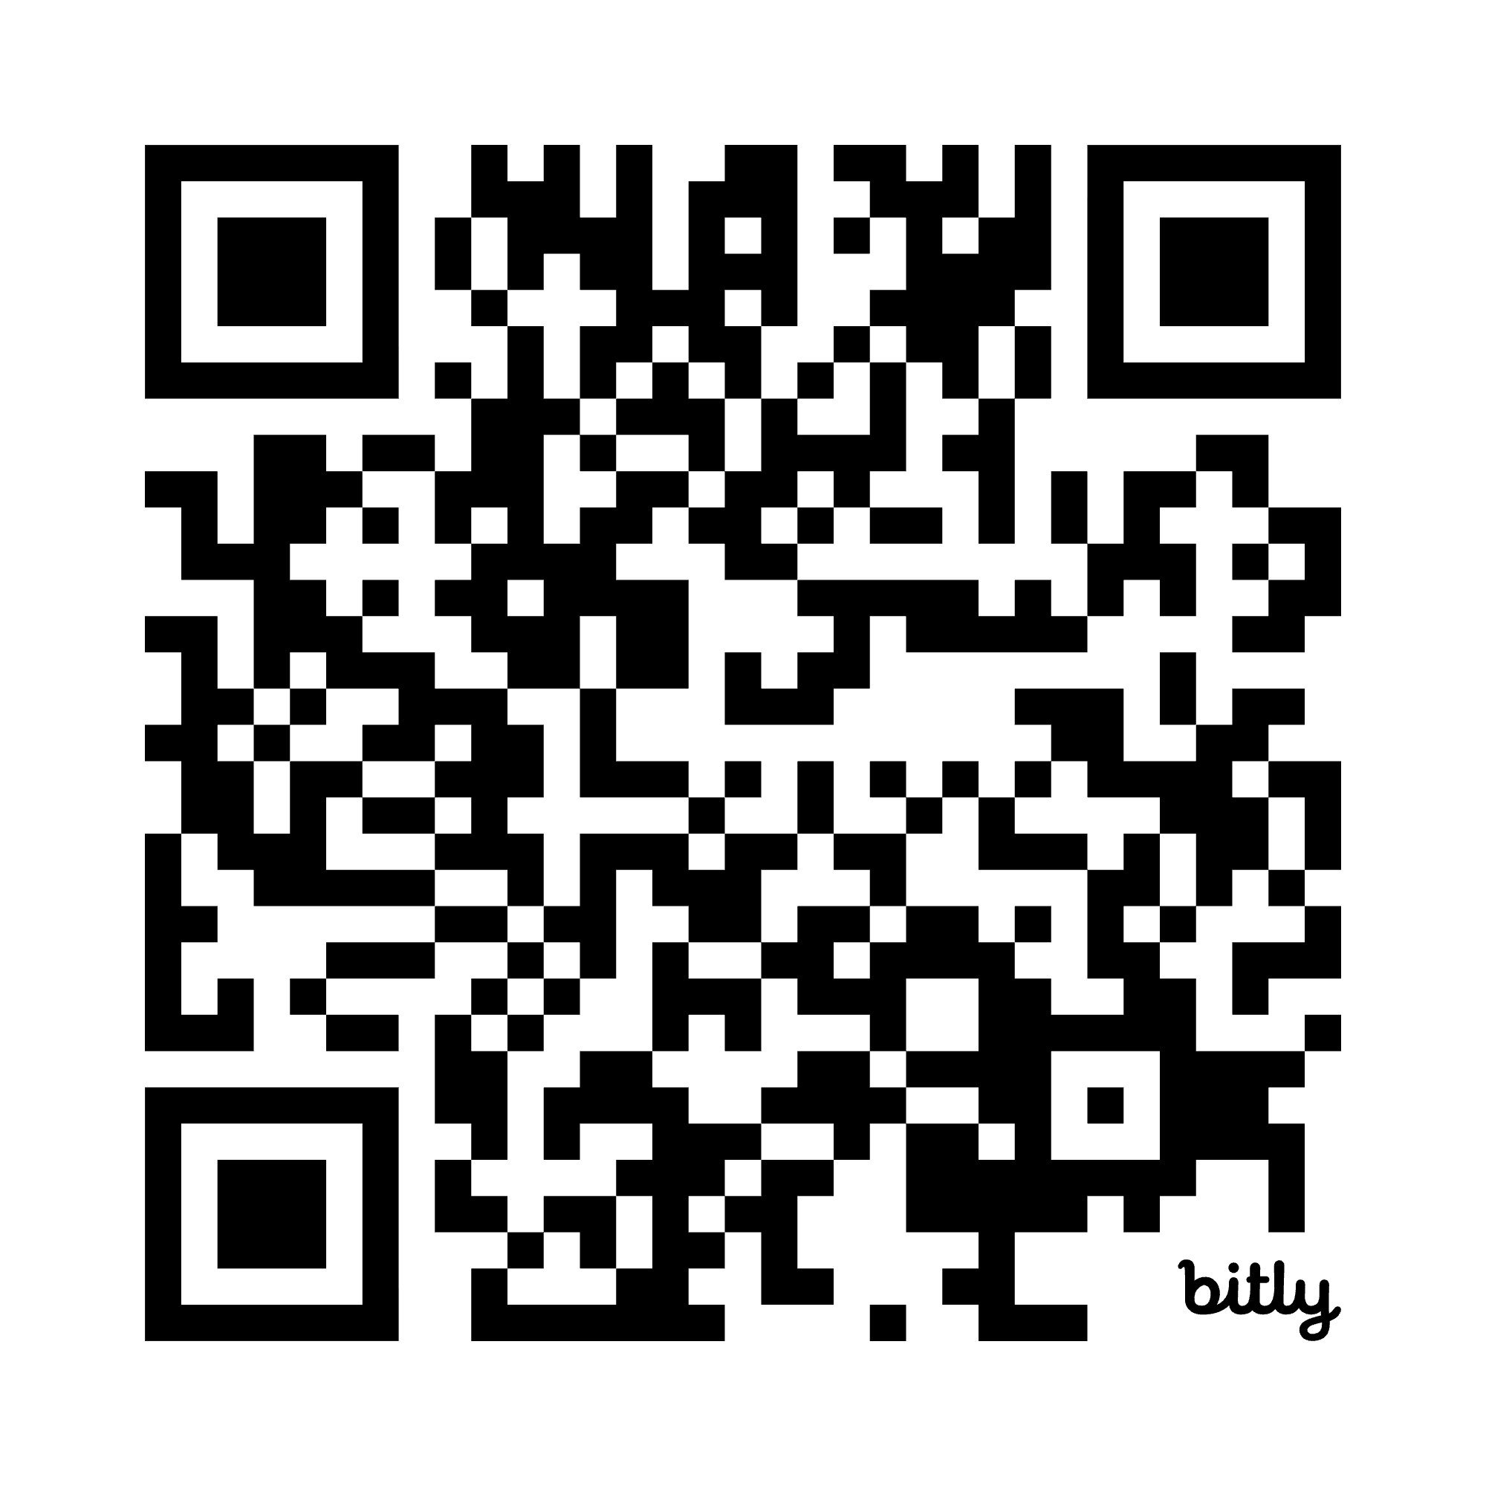
Scan Me!

Slide 3
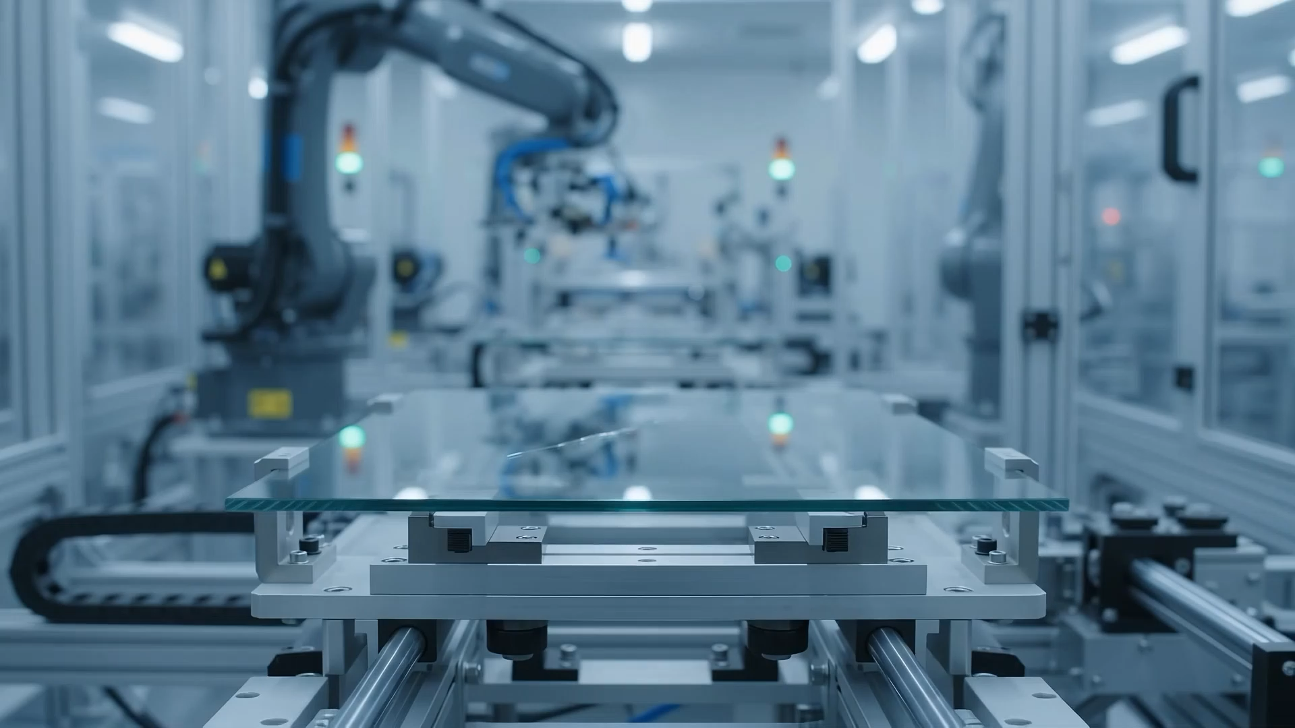
Repairing Glass Scratches with Laser

Slide 4
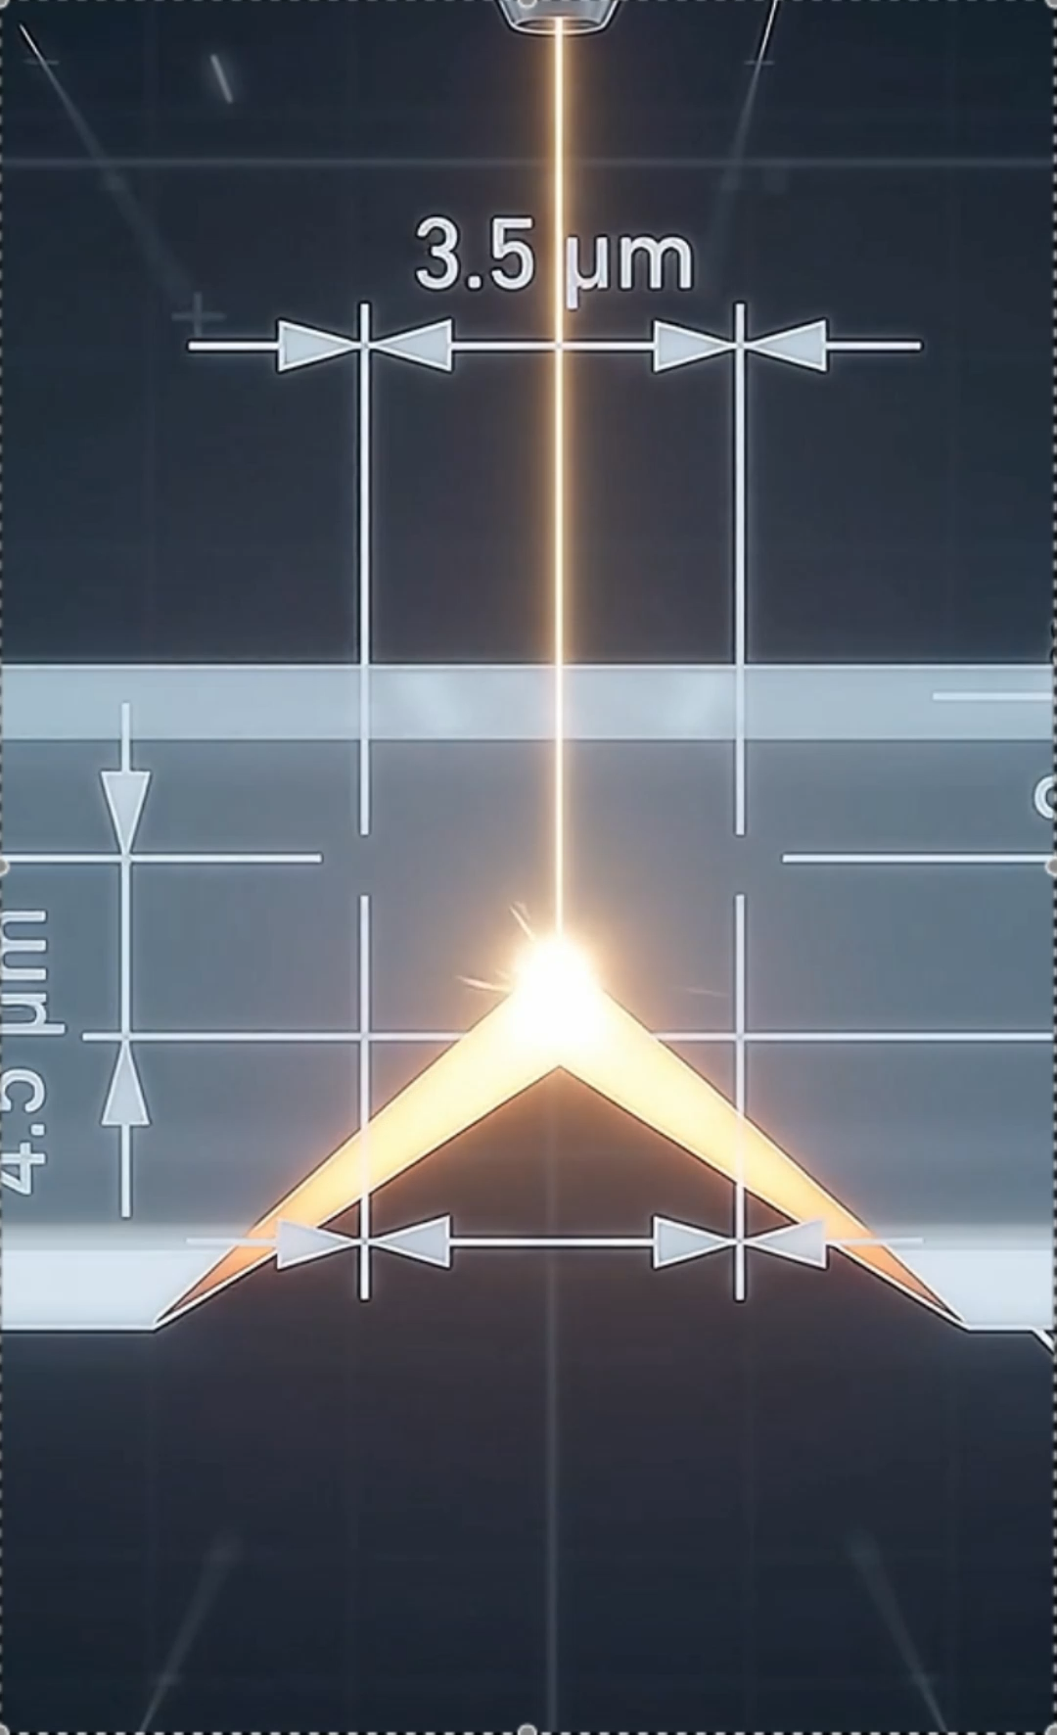
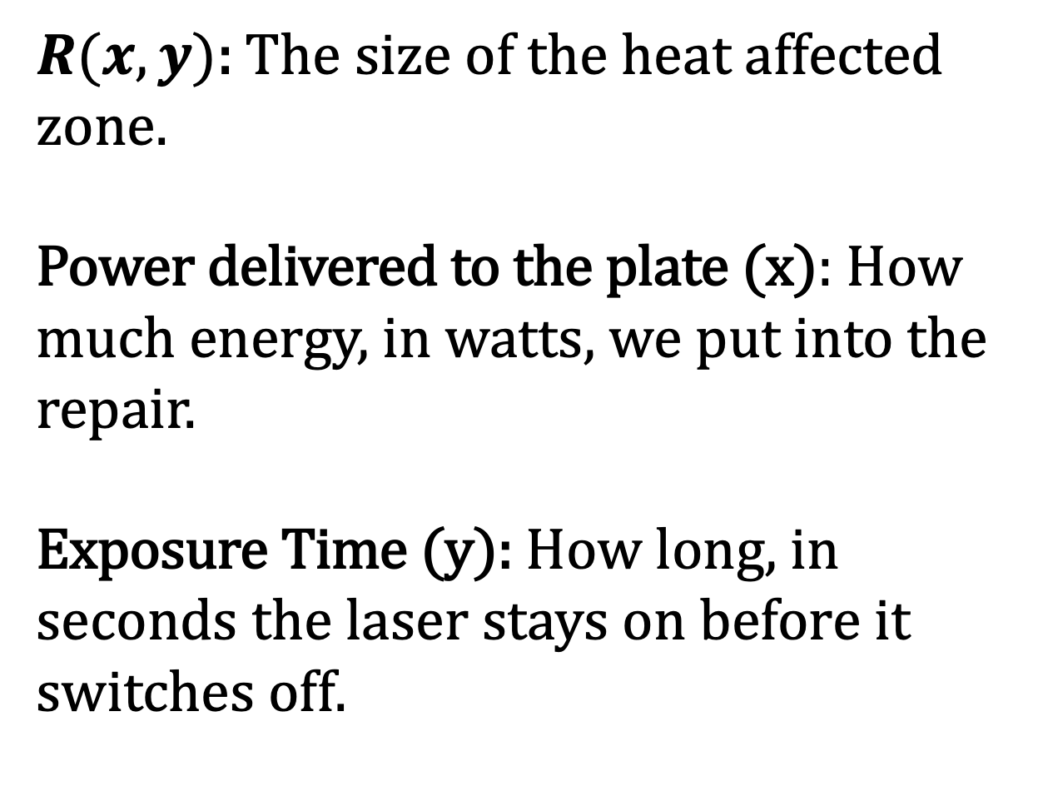
What are we most interested in?
$R(x, y)$: The size of the heat affected zone.
Power delivered to the plate (x): How much energy, in watts, we put into the repair.
Exposure Time (y): How long, in seconds the laser stays on before it switches off.

Slide 5
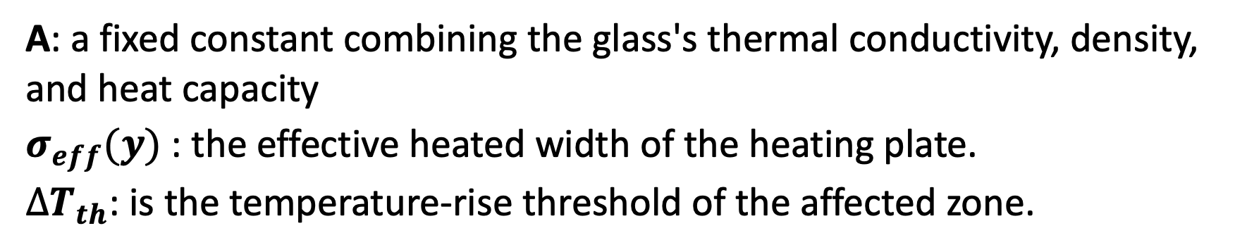
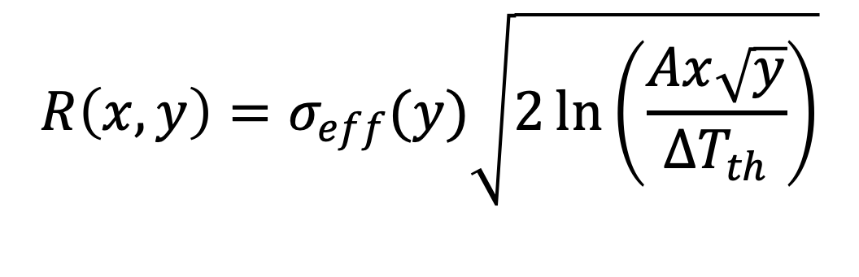
The Objective Function
Objective Function:
$$R\left(x, y\right)=σ_{eff}(y)\sqrt{2\ln\left(\frac{Ax\sqrt{y}}{∆T_{th}}\right)}$$
A: a fixed constant combining the glass's thermal conductivity, density, and heat capacity
$σ_{eff}(y)$: the effective heated width of the heating plate.
$∆T_{th}$: is the temperature-rise threshold of the affected zone.

Slide 6
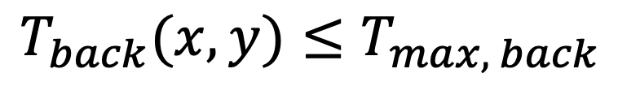
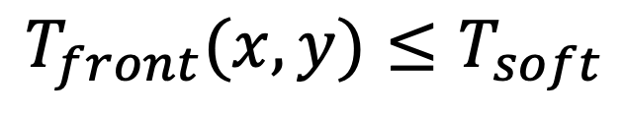
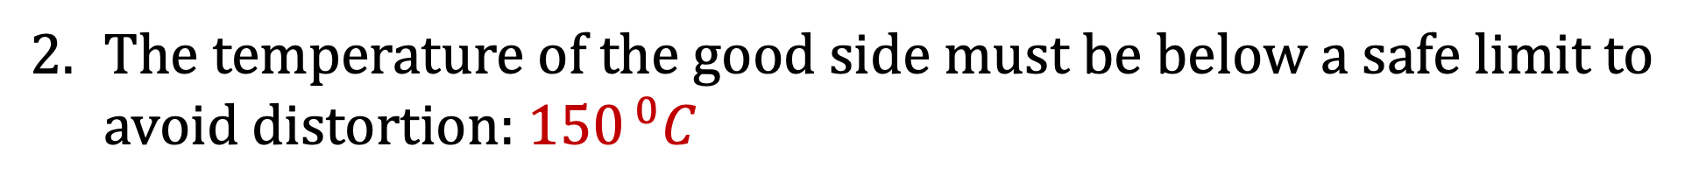
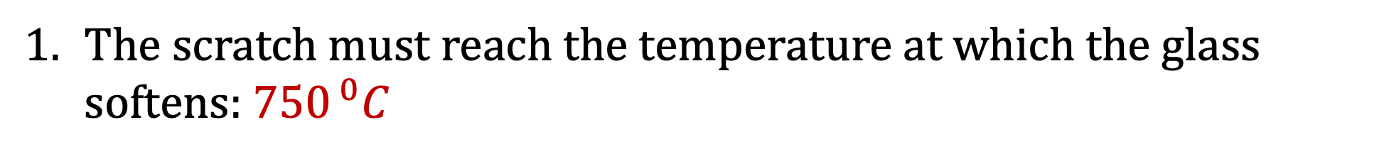
The Constraints
The scratch must reach the temperature at which the glass softens: ${750}^{ 0}C$
$$T_{front}(x,y)≤T_{soft}$$
The temperature of the good side must be below a safe limit to avoid distortion: ${150}^{ 0}C$
$$T_{back}(x,y)≤T_{max, back}$$

Slide 7
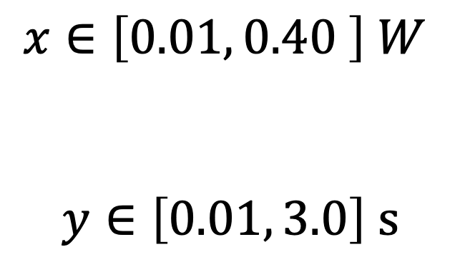
The Constraints - Last One, I Promise!
The power (x) and exposure time (y) must fall within a specified range
$$x∈\left[0.01, 0.40 \right] W$$
$$y∈\left[0.01, 3.0\right] s$$

Slide 8


Let’s Find the Perfect x and y to fix the Scratch!
Open “laser_repair_optimization_xy.m” in MATLAB

